Slide 1

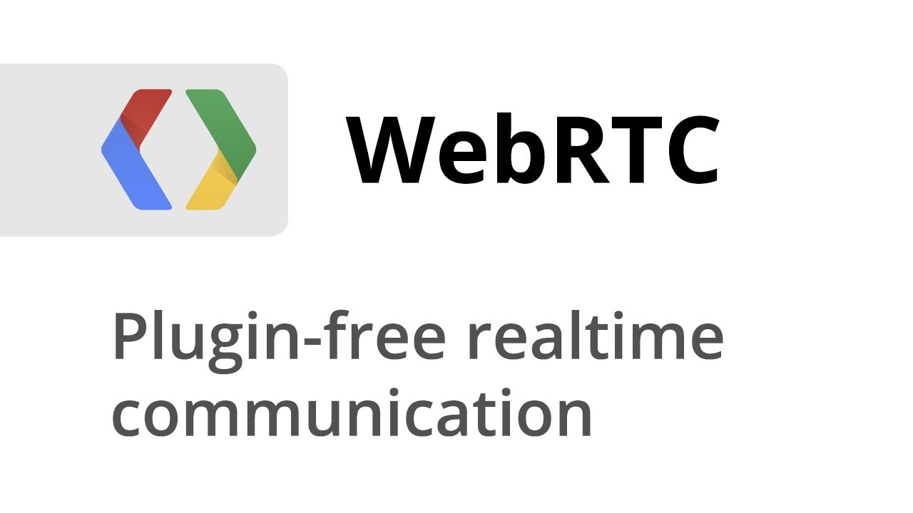
WebRTC Working and Explained
WebRTC is a powerful open-source technology that enables real-time communication directly between web browsers, facilitating seamless video conferences, voice calls, and data sharing. In this presentation, we will explore the inner workings of WebRTC and its various components.

Slide 2

What is WebRTC?
Real-time Communication
Peer-to-Peer Connections
Media Streaming
WebRTC supports high-quality audio and video streaming, making it ideal for applications such as video conferencing and live streaming.
WebRTC enables instant communication between web browsers without the need for additional plugins or software installations.
WebRTC establishes direct connections between browsers, allowing for efficient data transfer and low-latency communication.

Slide 3
Components of WebRTC
WebRTC API
MediaStream
RTCPeerConnection
The WebRTC API provides JavaScript functions and interfaces for developers to implement real-time communication features in web applications.
The MediaStream API allows access to audio and video streams from local devices, enabling real-time media capture and playback.
The RTCPeerConnection API establishes and manages peer-to-peer connections, enabling secure and efficient data transfer between browsers.

Slide 4

Working of WebRTC
1
Accessing Local Media
WebRTC captures audio and video streams from local devices, such as cameras and microphones, using the MediaStream API.
2
Establishing Peer Connection
The RTCPeerConnection API creates a direct connection between browsers, enabling real-time communication without the need for intermediaries.
3
Secure Data Transfer
WebRTC uses encryption and authentication mechanisms to ensure the privacy and integrity of data transmitted between browsers.

Slide 5
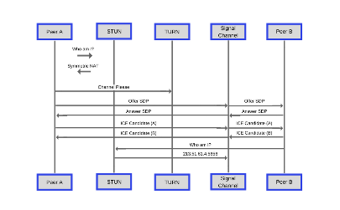
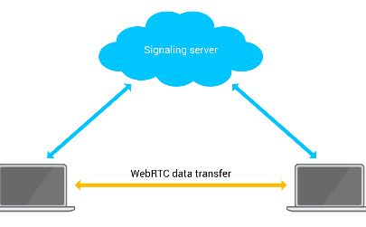
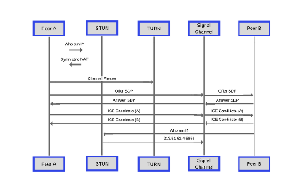
Signaling Process in WebRTC
Offer/Answer Exchange
Signaling Channel
Session Description Protocol (SDP)
Browsers exchange offer and answer messages to negotiate the parameters of the connection, such as codecs and network addresses.
The signaling channel facilitates the exchange of signaling data between browsers, often utilizing a signaling server or a WebSocket connection.
SDP is a standardized format used to describe the media capabilities and network details required for establishing WebRTC connections.

Slide 6

Advantages of using WebRTC
1
Compatibility
2
Low Latency
3
Cost-effective
WebRTC is supported by major web browsers, including Chrome, Firefox, Safari, and Edge, ensuring broad compatibility for users.
Direct peer-to-peer connections minimize latency, resulting in real-time communication with minimal delays.
Eliminating the need for additional software or plugins reduces costs for both developers and end-users.

Slide 7

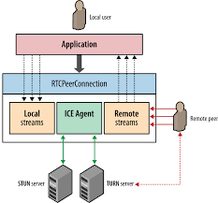

Slide 8
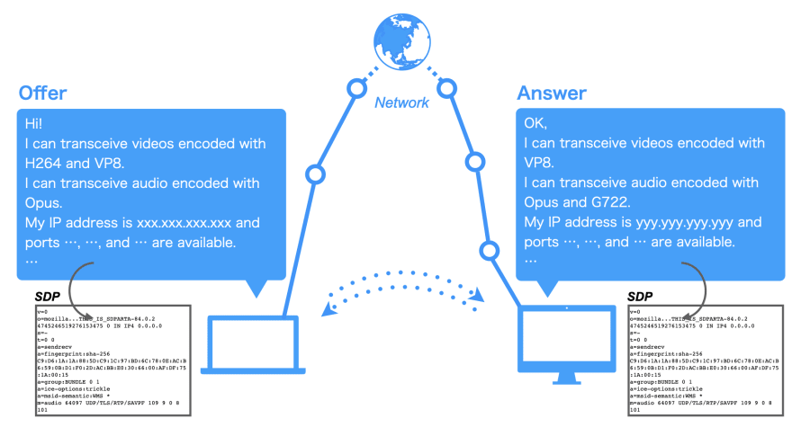

Slide 9
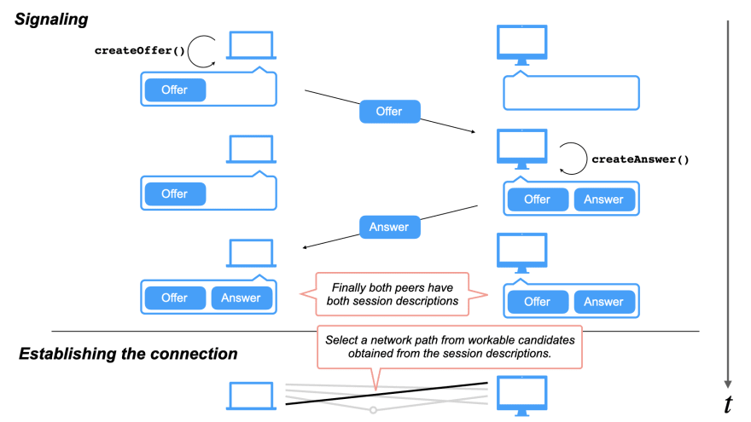

Slide 10
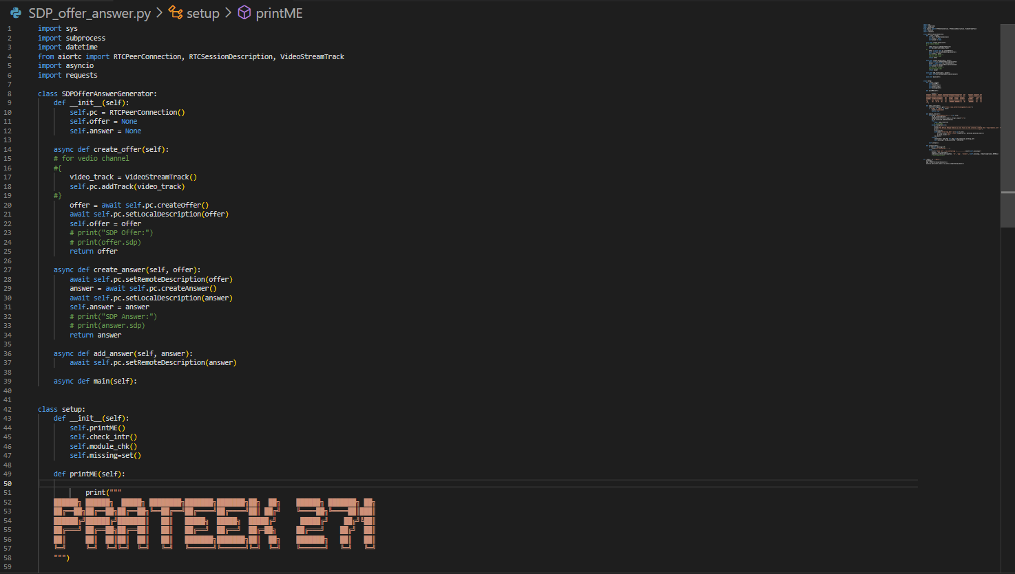

Slide 11
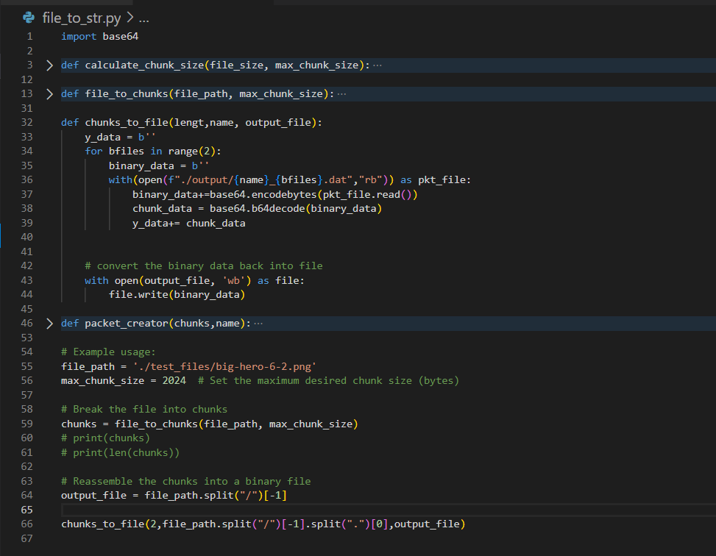

Slide 12

Mobile Version of Our Project

Slide 13

Conclusion
WebRTC revolutionizes real-time communication on the web by providing developers with a powerful, standardized, and cross-browser API. Its low latency, easy integration, and broad compatibility make it an ideal choice for a wide range of applications.

